Slide 1


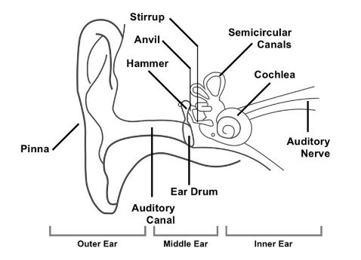
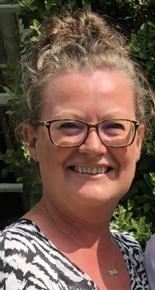

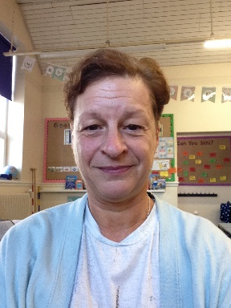


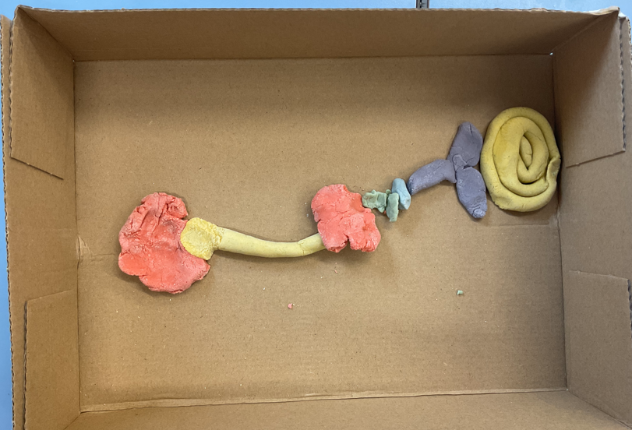

Year 4
Autumn Term 2024
Drop off time: 8:40am – 8:50am
Pick up time: 3:15pm – 3:25pm
Year 4 Team
P.E.
4A – Monday & Thursday
4B – Tuesday & Thursday
4C – Wednesday & Thursday
This term in Geography we will be learning about what makes the UK great. In Science, we will be learning about parts of the ear and how sound travels.
4A
Mrs Atherton
4C
Mrs Mawdsley
4B
Miss Hussein
Hook day:
Making the parts of the ear.
All children should be reading for at least 15 minutes every day.
Please record this in their reading record.

