Slide 1
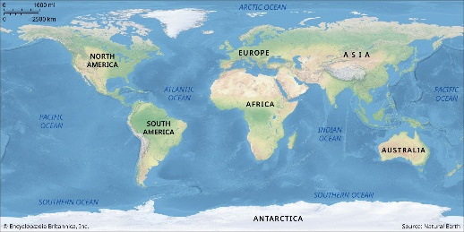
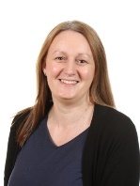
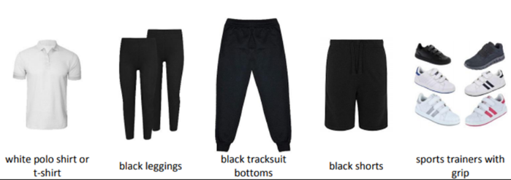
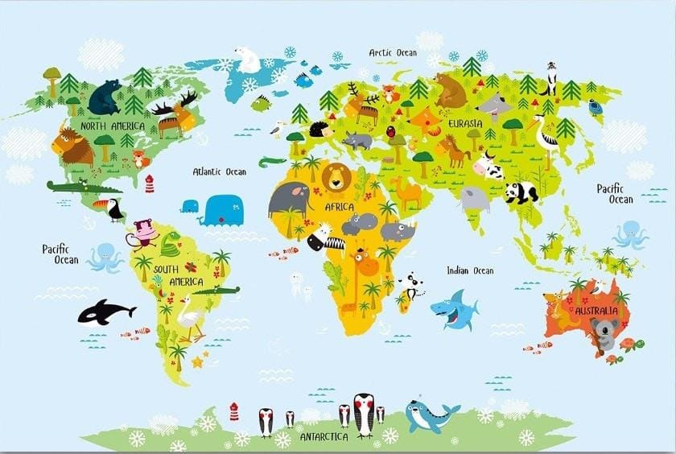
Year 2
Autumn Term 2024
Drop off time: 8:40am – 8:50am
Pick up time: 3:15pm – 3:25pm
Year 2 Team
P.E.
This term in Geography we will be learning about the seven continents and five oceans. In Science, we will be learning about animals, including humans.
2A – Tuesday & Thursday
2B – Wednesday & Thursday
2C –Thursday & Friday
2A
Miss Henry
2C
Mrs Lavorini & Mrs Kerr
2B
Miss Wood
Hook day:
We found about about animals on different continents and made fact files and mask.
All children should be reading for at least 15 minutes every day.
Please record this in their reading record.

